Slide 1

GIS+ Focal Statistics
Prof. Dr. Holger Weinacker
Brigitte Häuser, Guilherme Arruda, Manuel Händel

Slide 2
Project Presentation
The Challenge
The Context
Problem statement
Create an image-filtering tool using the same concepts as Focal Statistics from ArcGIS.
The image-filtering tool is a "moving window" that calculates statistics given a specific window size and shape. Implemented statistics: average, maximum, minimum, std deviation and variance.
Programatically the most difficult part was implementing the different window shapes, especially at the edge of the image, when the window extended past the image boundaries.

Slide 3
Used packages
Base Python: standard Python libraries, simplifying the programming process and removing the need to rewrite commonly used commands.
Numpy: support for large, multi-dimensional arrays and matrices, along with a large collection of high-level mathematical functions to operate on these arrays.
Matplotlib: comprehensive library for creating static, animated, and interactive visualizations.
Notes:
Numpy for the creating the images and storing 2d arrays
Matplotlib for plotting the overall results

Slide 4
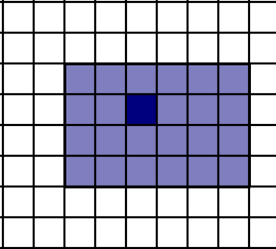
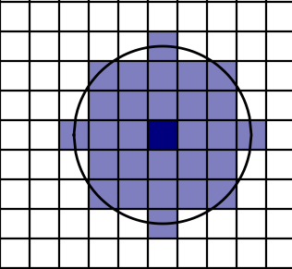
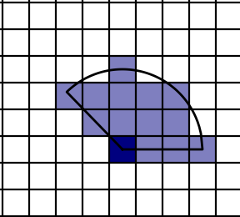
The different neighborhood types
Fig. 1 shows the different shapes of the filtering tools and its different central pixels: a) rectangle, b) circle and c) wedge window
The Neighborhood class dictates the shape of the area around each cell used to calculate the statistics.
Available types of neighborhood:
Rectangle (Square inclusive)
Circle
Wedge
c) radius = 3, start angle = 0°, end angle = 135°
a) width = 6, height = 4
b) radius = 3
1
Notes:
Important to say: For circle and wedge: All pixels whose center falls in the radius are included. As the picture shows, the wedge doesn't represent a total circle, but only a segment from the start to the ending.
For the circle, the central pixel is in the middle of the circle. For the wedge, the central pixel is located at the middle of the imaginary circle.
But, for the rectangle, sometimes we cant define a middle point.

Slide 5
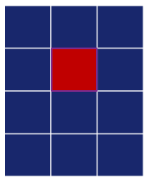
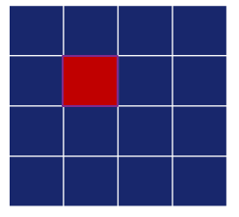
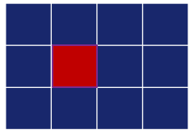
Assigning the central pixel for the rectangle
Rectangle: central pixel is in the middle →
for even heights or widths, there is no middle pixel
For even width - left assigned
For even height - top assigned
For even width and height: top-left assigned
Notes:
Even width: the central pixel is automatically assigned to the left pixel of the two possible middle pixels.
Even height: the central pixel is the top central pixel.
Even height and width, the central pixel is top-left assigned

Slide 6
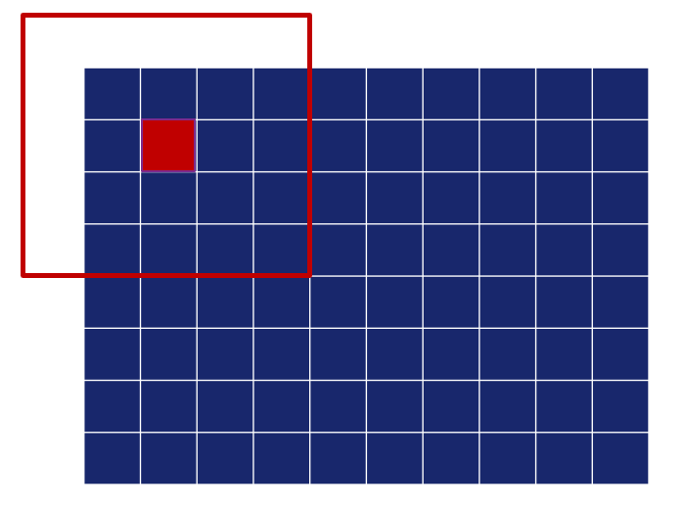
Edge problem
Problem that arises when the processed cell is close to the edge of the raster and the neighborhood window would reach outside of the boundary
Edge case for a square neighborhood with a height and width of 5. The red line shows the neighborhood around the central pixel.
Notes:
Problem -> window reaches out of boundary In our case, two ways were utilized to dealing with that

Slide 7
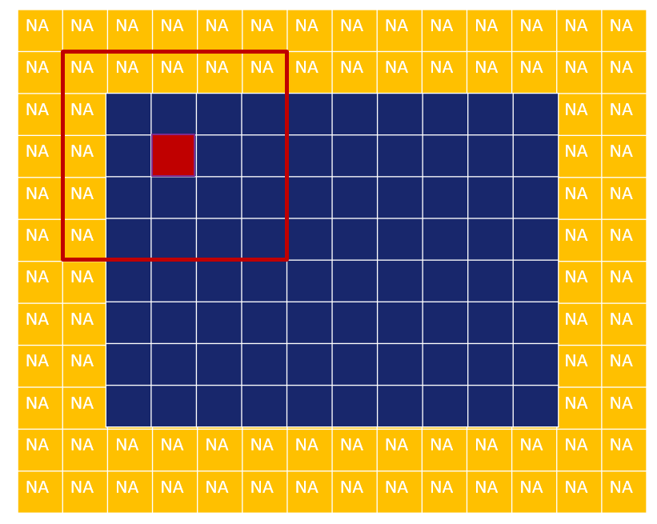
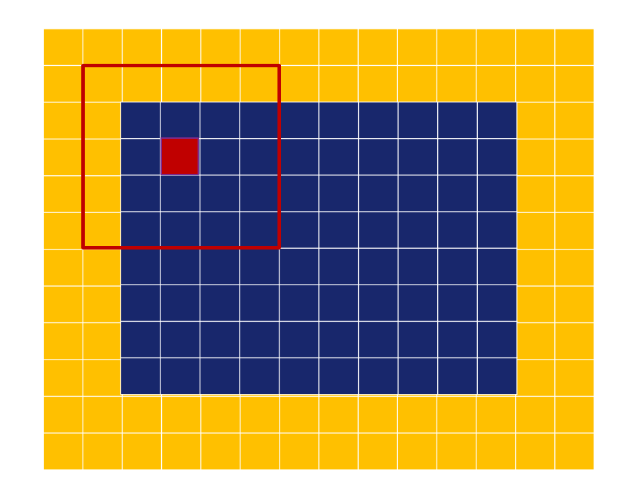
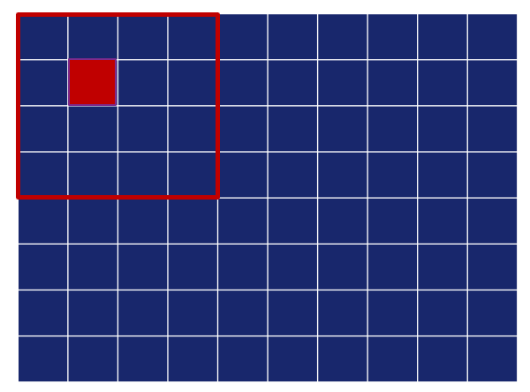
Edge problem - Two solutions
Padding → NA border
Categorising edge cases → decreases neighborhood size
Notes:
Approach 1: Add cells around the input raster (called padding). Now window no longer out of boundary, but there are NAs in the window -> two ways to deal with that, set the value to na or apply the statistic just on the remaining vaues.
Approach 2: Shrink neighborhood window. Now no more cells outside of boundary inside the window. In order to do so, the algorithm has to determine whether the processed cell is at the edge of the input raster or not.

Slide 8
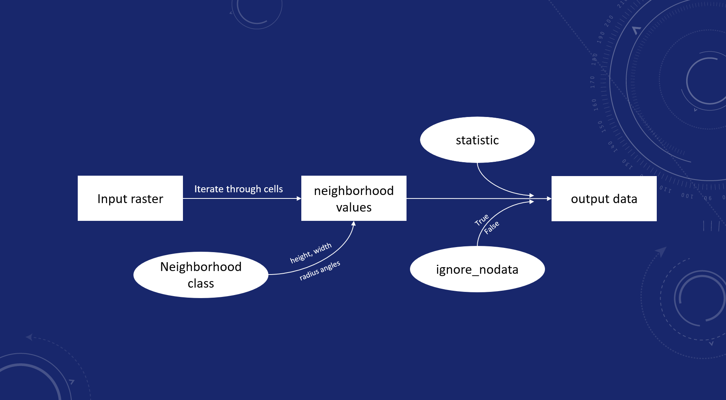
Code scheme
Notes:
This slide shows the overall flow of our coding. It all starts with an input raster. The algorithm iterates through all of its cells and colects all values that are in the neighbourhood window. This window is defined by the shape (rectangle, circle, wedge) and parameters (height, width, radius, angles). When all values are collected we calculate the statistics (max, min, std dev, mean for example). In this step, when there are NAs, the parameter "ignore no data" determines how to deal with those cells, by the 2 ways we explained before. The resulting value is going to be put into the output raster.

Slide 9
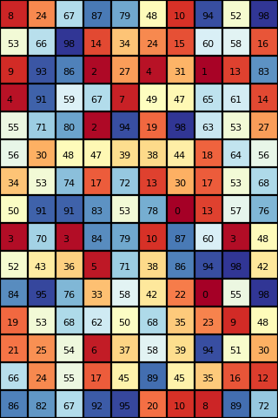
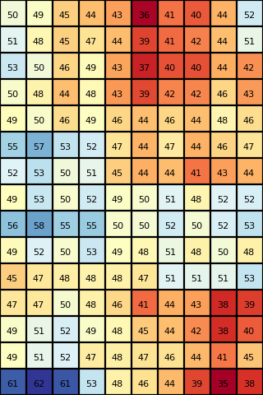
Results
Rectangle with width = 6 and height = 4, mean
Original data
Output data
Notes:
The last 3 slides will show the input and output of the focal statistics calculation for the 3 shapes and 3 different statistics.
Some examples for the results we have, with ignore_nodata = True

Slide 10
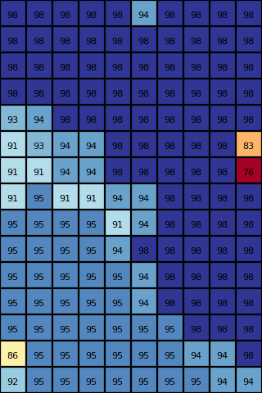
Results
Circle with radius = 3, max
Original data
Output data

Slide 11
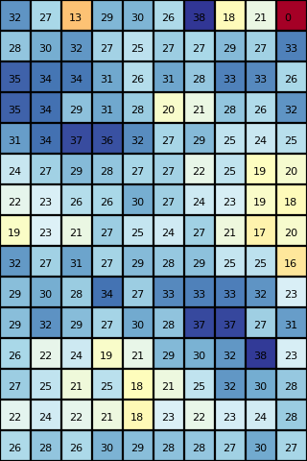
Results
Wedge with radius = 3, start angle = 0°, end angle = 135°, std dev
Original data
Output data
Notes:
Some examples for the results we have

